Slide 1
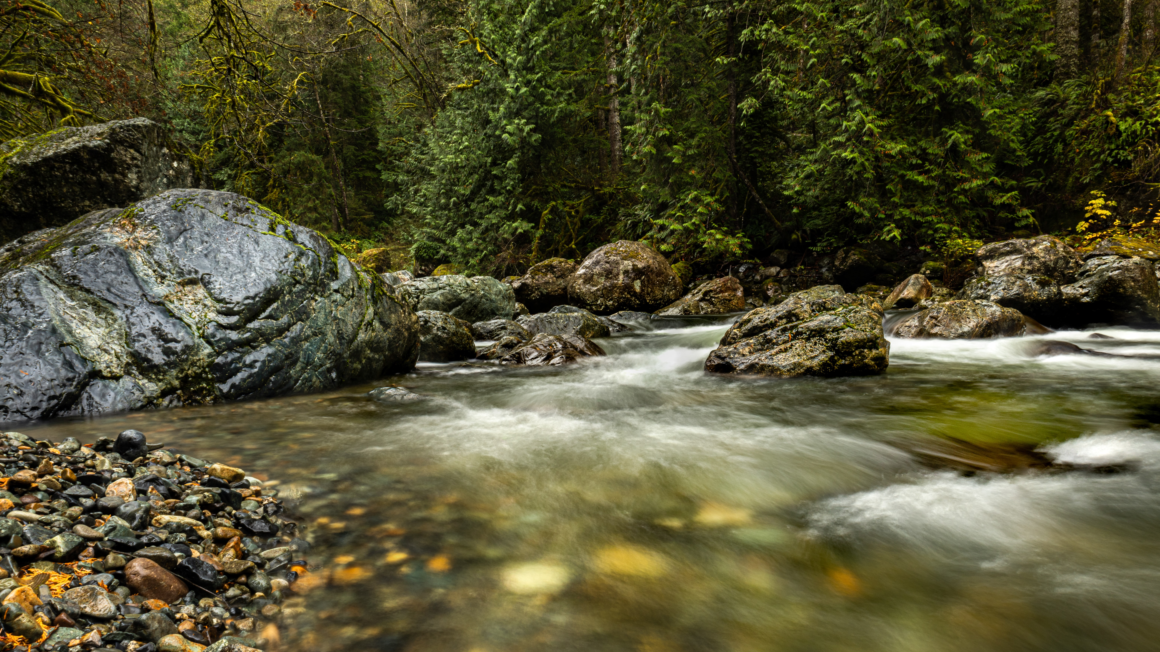


Climate Change and Hazards in the PNW:
Take-home Lessons on Adaptation
Guillaume Mauger

Slide 2
Climate change vulnerability is about more than just impacts: To plan for climate change, we also need to know when consequences are important, and what is our capacity to adapt.
Notes:
I’m here to talk to you all about our work on flooding and helping communities prepare for climate change in floodplains.
We generally think of assessing climate change risks in terms of three factors: (1) how much change will occur, (2) how much things have to change to matter, and what is our capacity to adapt to those changes.
I’m a numbers geek at heart, so I’m naturally drawn to the first question – quantifying the impacts of climate change – and it’s where I’ve spent most of my time here at the Climate Impacts Group. All three are important, and all three will be an important part of our work for the next 25 years. But the 2nd and 3rd factors have gotten less attention in the past, and these are where I see the most potential for growth.
That’s my punchline: Over the next 25 years I see the potential for a lot more new work on these last two questions, while continuing our work on the 1st.

Slide 3
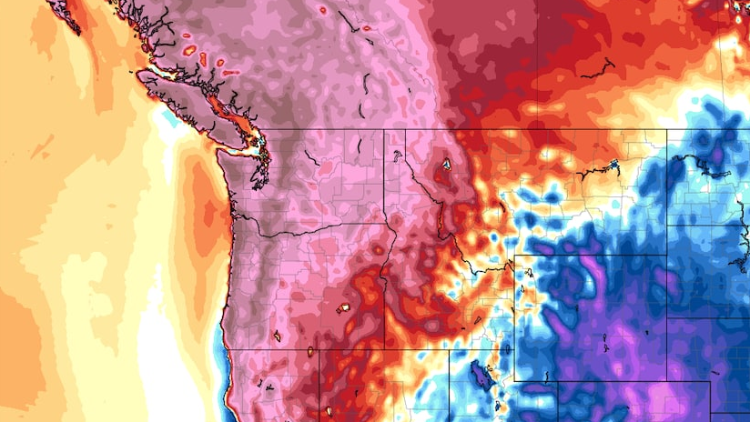
Vulnerability is not just about Impacts
Three factors:
  How much change?
  When does it matter?
  What is our capacity to adapt?
https://www.washingtonpost.com/weather/2021/06/25/pacific-northwest-heat-wave-seattle-portland/
Notes:
We generally think of assessing climate change risks in terms of three factors: (1) how much change will occur, (2) how much things have to change to matter, and what is our capacity to adapt to those changes.
I’m a numbers geek at heart, so I’m naturally drawn to the first question – quantifying the impacts of climate change. But the 2nd and 3rd factors have gotten less attention in the past, and these are where I see the most potential for growth.

Slide 4
Vulnerability is not just about Impacts
Three factors:
  Exposure
  Sensitivity
  Adaptive Capacity
https://www.washingtonpost.com/weather/2021/06/25/pacific-northwest-heat-wave-seattle-portland/
Notes:
We generally think of assessing climate change risks in terms of three factors: (1) how much change will occur, (2) how much things have to change to matter, and what is our capacity to adapt to those changes.
I’m a numbers geek at heart, so I’m naturally drawn to the first question – quantifying the impacts of climate change. But the 2nd and 3rd factors have gotten less attention in the past, and these are where I see the most potential for growth.

Slide 5
There is more than one way to prepare for climate change: Start simple, then add complexity as you need it.
Notes:
I’m here to talk to you all about our work on flooding and helping communities prepare for climate change in floodplains.
We generally think of assessing climate change risks in terms of three factors: (1) how much change will occur, (2) how much things have to change to matter, and what is our capacity to adapt to those changes.
I’m a numbers geek at heart, so I’m naturally drawn to the first question – quantifying the impacts of climate change – and it’s where I’ve spent most of my time here at the Climate Impacts Group. All three are important, and all three will be an important part of our work for the next 25 years. But the 2nd and 3rd factors have gotten less attention in the past, and these are where I see the most potential for growth.
That’s my punchline: Over the next 25 years I see the potential for a lot more new work on these last two questions, while continuing our work on the 1st.

Slide 6
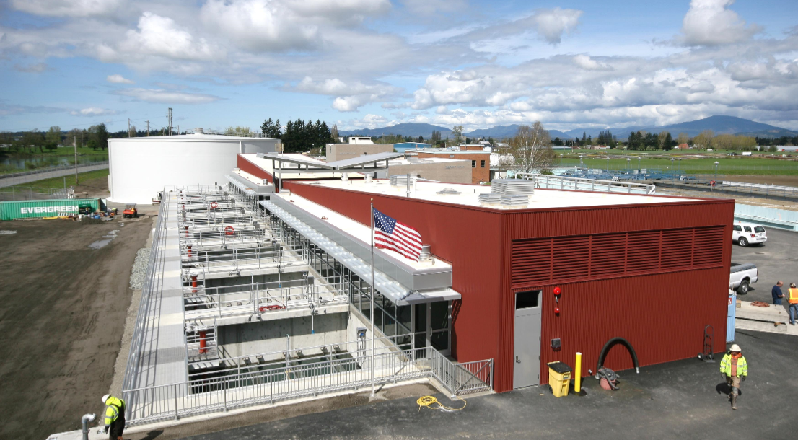
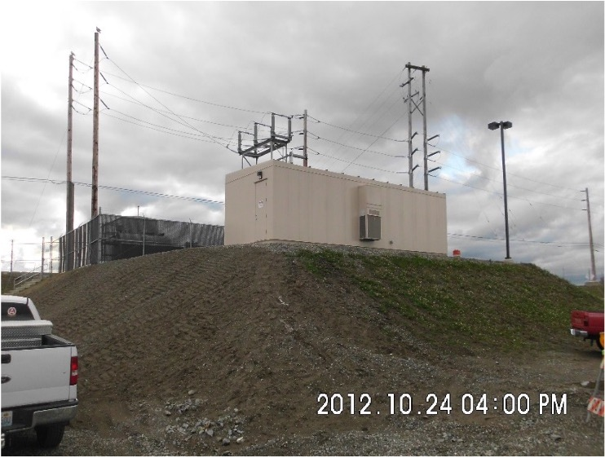
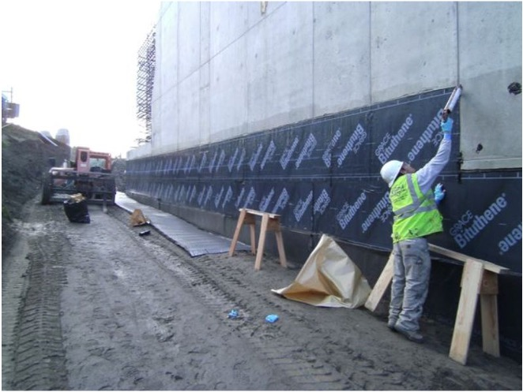
Anacortes Water Treatment Plant

Slide 7
Start with what you want to know:
By defining the problem, you can better hone in on the information you need.
Notes:
I’m here to talk to you all about our work on flooding and helping communities prepare for climate change in floodplains.
We generally think of assessing climate change risks in terms of three factors: (1) how much change will occur, (2) how much things have to change to matter, and what is our capacity to adapt to those changes.
I’m a numbers geek at heart, so I’m naturally drawn to the first question – quantifying the impacts of climate change – and it’s where I’ve spent most of my time here at the Climate Impacts Group. All three are important, and all three will be an important part of our work for the next 25 years. But the 2nd and 3rd factors have gotten less attention in the past, and these are where I see the most potential for growth.
That’s my punchline: Over the next 25 years I see the potential for a lot more new work on these last two questions, while continuing our work on the 1st.

Slide 8
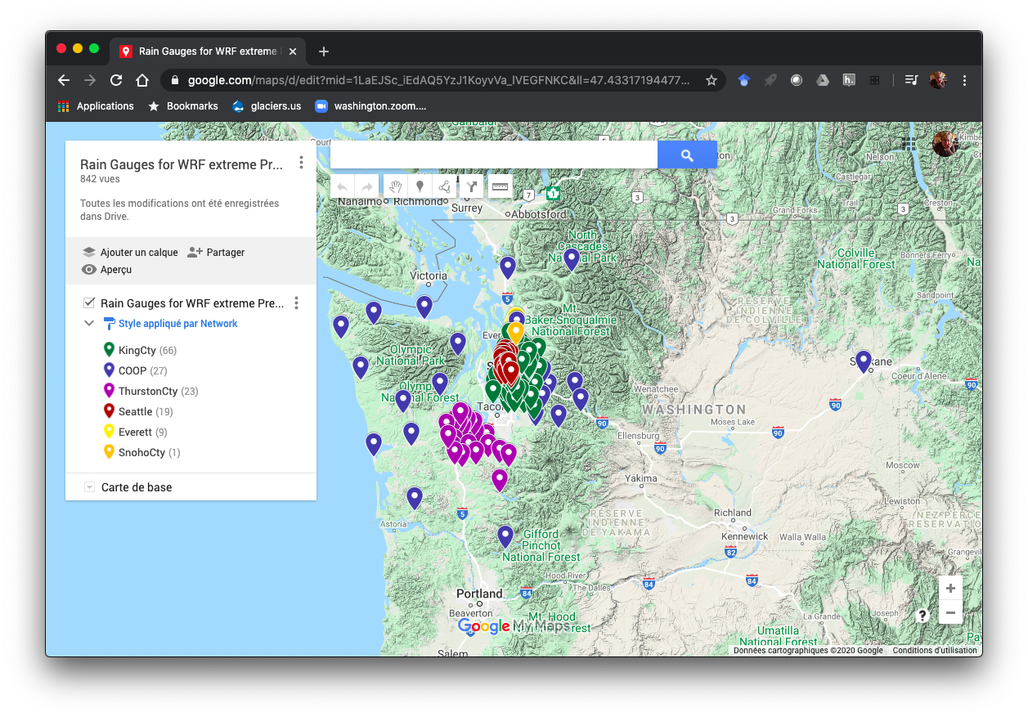
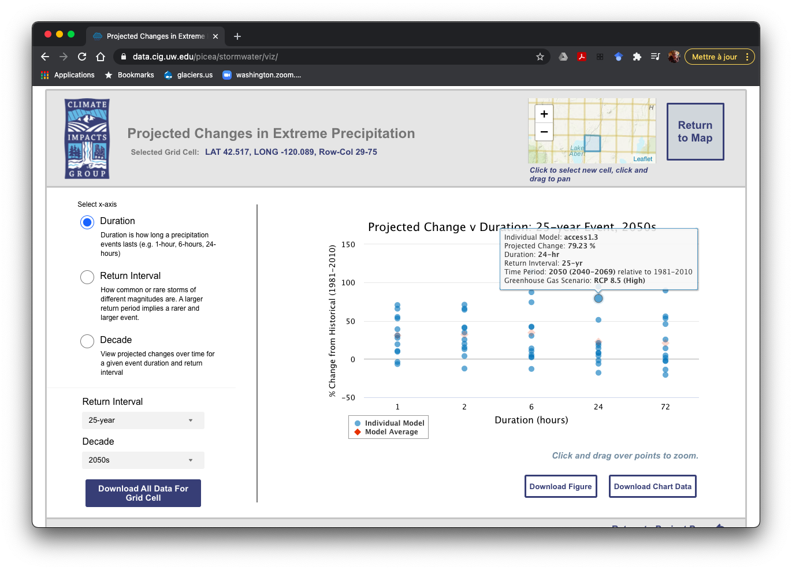


Impact on Stormwater Design
November 2019
https://cig.uw.edu/our-work/applied-research/heavy-precip-and-stormwater/
Notes:
Statistical / dynamical

Slide 9
There are lots of resources available to help you both assess impacts and plan for climate change.
Notes:
I’m here to talk to you all about our work on flooding and helping communities prepare for climate change in floodplains.
We generally think of assessing climate change risks in terms of three factors: (1) how much change will occur, (2) how much things have to change to matter, and what is our capacity to adapt to those changes.
I’m a numbers geek at heart, so I’m naturally drawn to the first question – quantifying the impacts of climate change – and it’s where I’ve spent most of my time here at the Climate Impacts Group. All three are important, and all three will be an important part of our work for the next 25 years. But the 2nd and 3rd factors have gotten less attention in the past, and these are where I see the most potential for growth.
That’s my punchline: Over the next 25 years I see the potential for a lot more new work on these last two questions, while continuing our work on the 1st.

Slide 10
New Data Guide: ‘‘Quantifying Sensitivity + Exposure’’
https://cig.uw.edu/projects/supporting-climate-resilient-floodplain-management-in-whatcom-and-snohomish-counties/

Slide 11
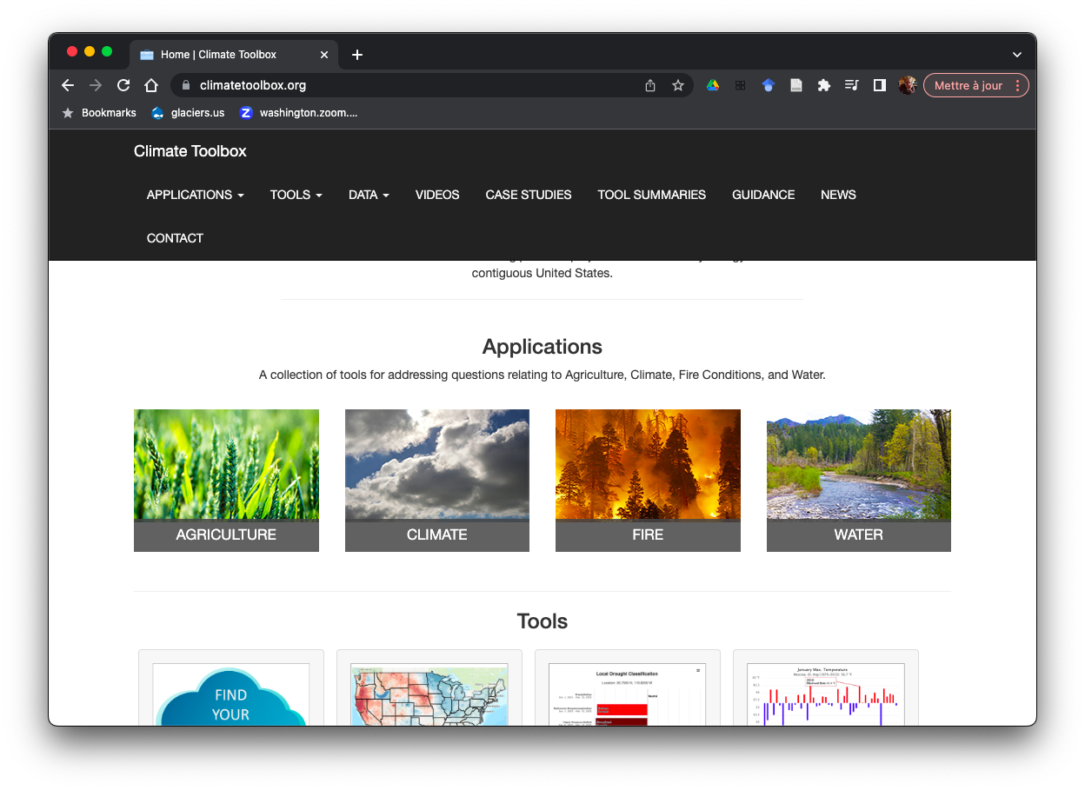
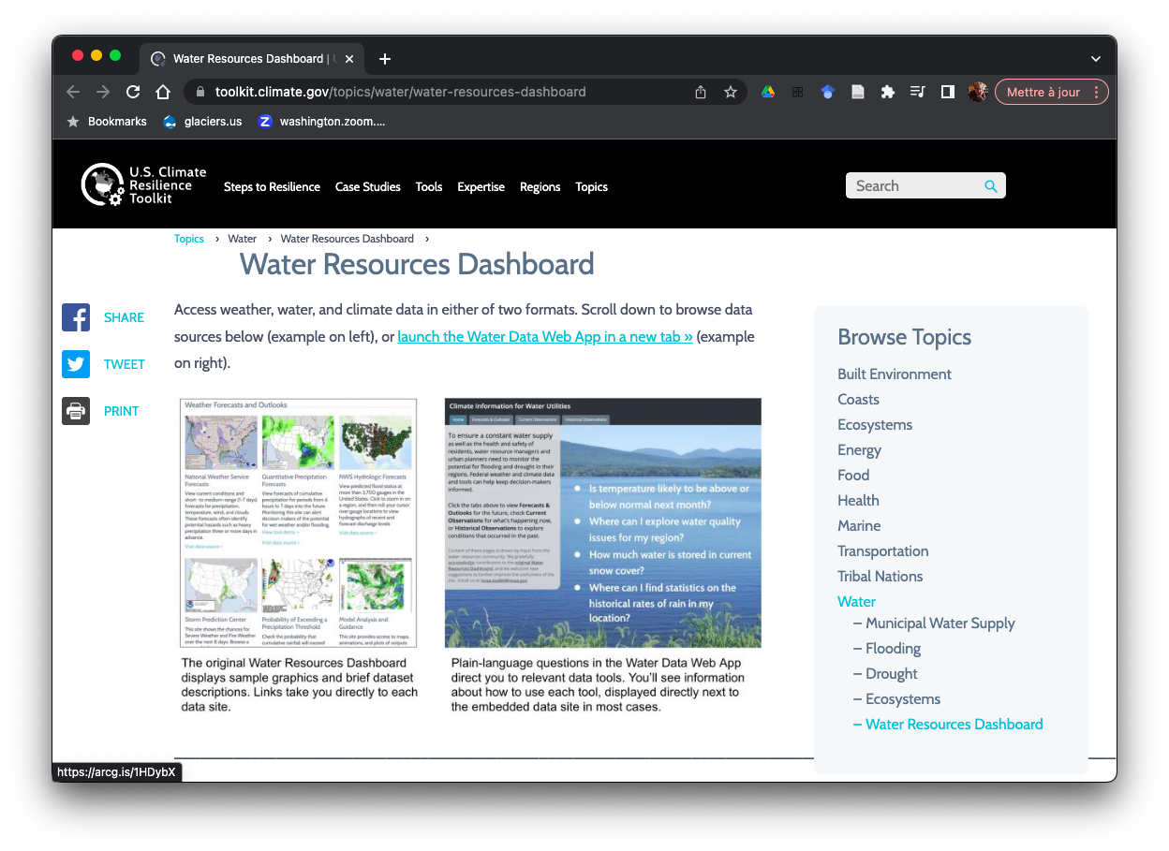
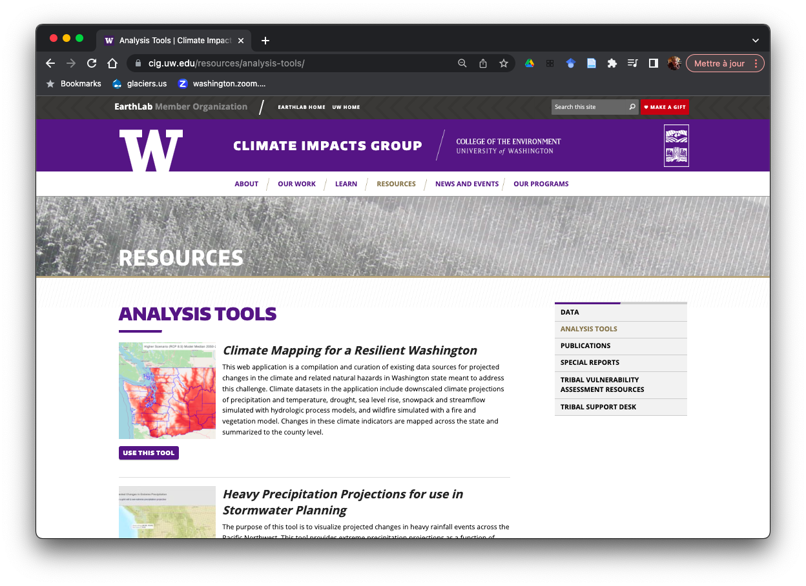
Resources for assessing impacts:
Climate Toolbox
https://climatetoolbox.org/
Water Resources Dashboard
https://toolkit.climate.gov/topics/water/water-resources-dashboard
Climate Impacts Group
https://cig.uw.edu/resources/analysis-tools/

Slide 12
Use sensitivity testing to explore impacts: ”What happens if” scenarios are a valuable way to explore vulnerabilities.
Notes:
I’m here to talk to you all about our work on flooding and helping communities prepare for climate change in floodplains.
We generally think of assessing climate change risks in terms of three factors: (1) how much change will occur, (2) how much things have to change to matter, and what is our capacity to adapt to those changes.
I’m a numbers geek at heart, so I’m naturally drawn to the first question – quantifying the impacts of climate change – and it’s where I’ve spent most of my time here at the Climate Impacts Group. All three are important, and all three will be an important part of our work for the next 25 years. But the 2nd and 3rd factors have gotten less attention in the past, and these are where I see the most potential for growth.
That’s my punchline: Over the next 25 years I see the potential for a lot more new work on these last two questions, while continuing our work on the 1st.

Slide 13
Use sensitivity testing to explore impacts
https://www.wucaonline.org/assets/pdf/awwa2018-portland-resiliency.pdf
Notes:
Statistical / dynamical

Slide 14
Learn from events as they happen: These are “dress rehearsals” for the future, and probably the best way to understand what works / doesn’t.
Notes:
I’m here to talk to you all about our work on flooding and helping communities prepare for climate change in floodplains.
We generally think of assessing climate change risks in terms of three factors: (1) how much change will occur, (2) how much things have to change to matter, and what is our capacity to adapt to those changes.
I’m a numbers geek at heart, so I’m naturally drawn to the first question – quantifying the impacts of climate change – and it’s where I’ve spent most of my time here at the Climate Impacts Group. All three are important, and all three will be an important part of our work for the next 25 years. But the 2nd and 3rd factors have gotten less attention in the past, and these are where I see the most potential for growth.
That’s my punchline: Over the next 25 years I see the potential for a lot more new work on these last two questions, while continuing our work on the 1st.

Slide 15




2015: A preview of the future
Warmest year on record for the NW
~5ºF warmer than pre-industrial
7th driest January to June in the Northwest
Lowest snowpack on record for WA
30% of normal (1970-1999 average)
Data: NCA 2018
Figure: Climate Impacts Group

Slide 16
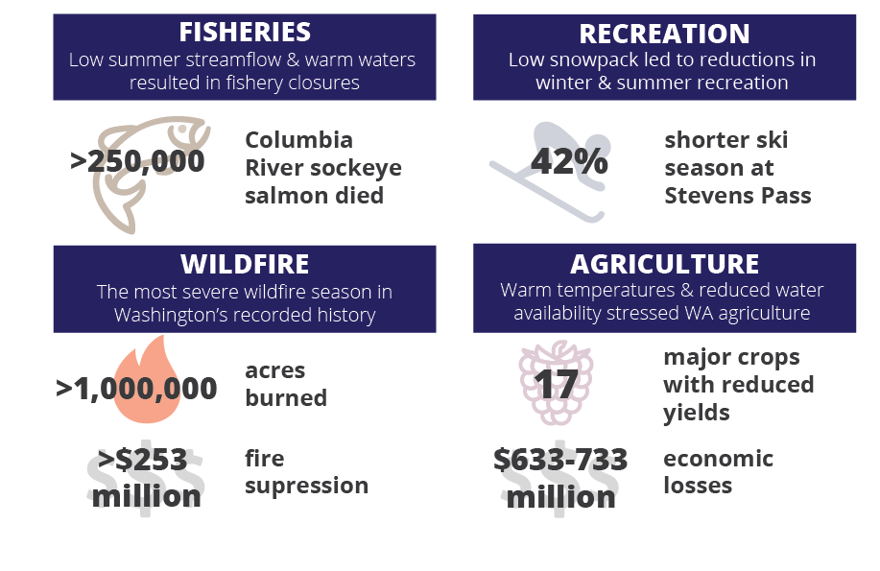
2015:
Data: NCA 2018
Figure: Climate Impacts Group

Slide 17
Leverage existing science to benefit from economies of scale: Impacts studies can often be conducted over large areas, or at least build on past experience.
Notes:
I’m here to talk to you all about our work on flooding and helping communities prepare for climate change in floodplains.
We generally think of assessing climate change risks in terms of three factors: (1) how much change will occur, (2) how much things have to change to matter, and what is our capacity to adapt to those changes.
I’m a numbers geek at heart, so I’m naturally drawn to the first question – quantifying the impacts of climate change – and it’s where I’ve spent most of my time here at the Climate Impacts Group. All three are important, and all three will be an important part of our work for the next 25 years. But the 2nd and 3rd factors have gotten less attention in the past, and these are where I see the most potential for growth.
That’s my punchline: Over the next 25 years I see the potential for a lot more new work on these last two questions, while continuing our work on the 1st.

Slide 18
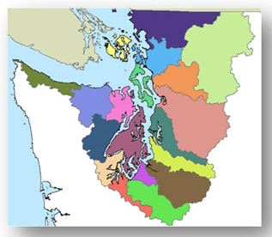
Recent Fine-Scale Hydrologic Model Projections
Nooksack, Stillaguamish
Dynamical Downscaling
WWU, 2022
Skagit
Statistical Downscaling
UW CEE, 2018
15 West Sound watersheds
Statistical Downscaling
PNPTC, 2019
Snohomish, Cedar, Green, Puyallup
Dynamical Downscaling
UW CIG, in progress
(this list is likely incomplete)

Slide 19
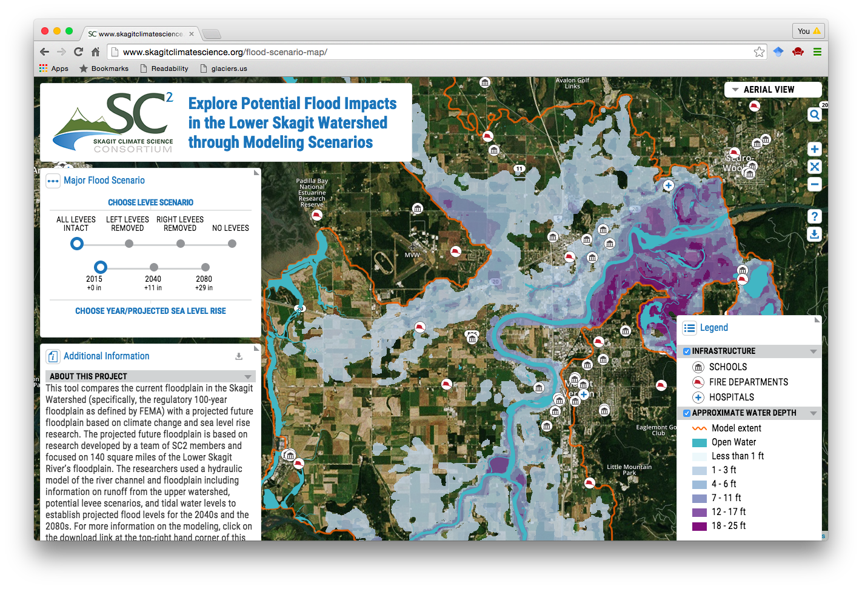
Example: Current v Future Flooding in the Skagit Valley
http://www.skagitclimatescience.org/flood-scenario-map/

Slide 20
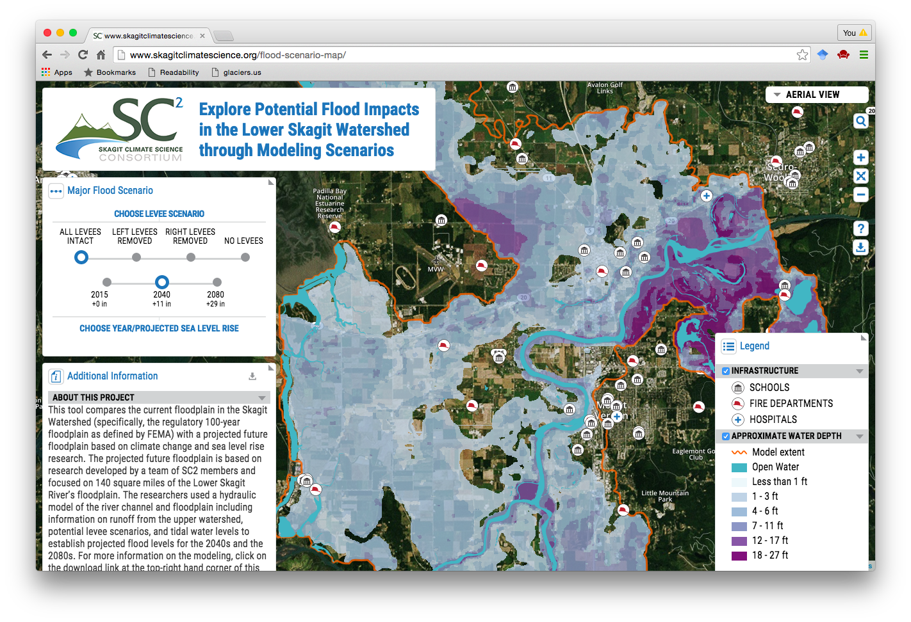
Example: Current v Future Flooding in the Skagit Valley
http://www.skagitclimatescience.org/flood-scenario-map/

Slide 21
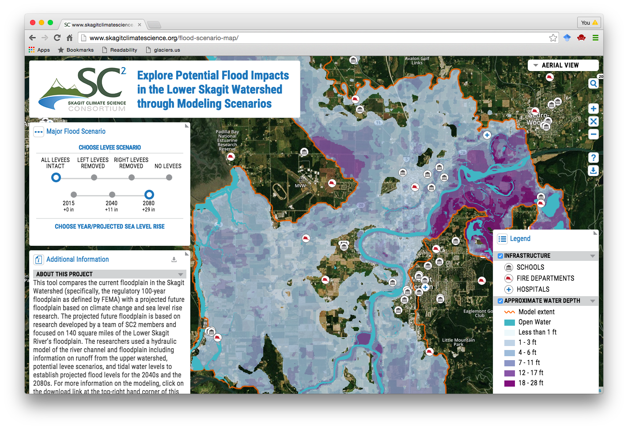
Example: Current v Future Flooding in the Skagit Valley
http://www.skagitclimatescience.org/flood-scenario-map/

Slide 22
Research priorities should directly address management needs: This is best done by co-developing an agenda with stakeholders and researchers.
Notes:
I’m here to talk to you all about our work on flooding and helping communities prepare for climate change in floodplains.
We generally think of assessing climate change risks in terms of three factors: (1) how much change will occur, (2) how much things have to change to matter, and what is our capacity to adapt to those changes.
I’m a numbers geek at heart, so I’m naturally drawn to the first question – quantifying the impacts of climate change – and it’s where I’ve spent most of my time here at the Climate Impacts Group. All three are important, and all three will be an important part of our work for the next 25 years. But the 2nd and 3rd factors have gotten less attention in the past, and these are where I see the most potential for growth.
That’s my punchline: Over the next 25 years I see the potential for a lot more new work on these last two questions, while continuing our work on the 1st.

Slide 23
Example: Climate study priorities in Pierce County

Slide 24
Example: Climate study priorities in Pierce County

Slide 25
Example: Climate study priorities in Pierce County

Slide 26
Example: Climate study priorities in Pierce County

Slide 27
Climate change is better addressed through prioritization than project design: Both are important, but with limited resources we need to be judicious.
Notes:
I’m here to talk to you all about our work on flooding and helping communities prepare for climate change in floodplains.
We generally think of assessing climate change risks in terms of three factors: (1) how much change will occur, (2) how much things have to change to matter, and what is our capacity to adapt to those changes.
I’m a numbers geek at heart, so I’m naturally drawn to the first question – quantifying the impacts of climate change – and it’s where I’ve spent most of my time here at the Climate Impacts Group. All three are important, and all three will be an important part of our work for the next 25 years. But the 2nd and 3rd factors have gotten less attention in the past, and these are where I see the most potential for growth.
That’s my punchline: Over the next 25 years I see the potential for a lot more new work on these last two questions, while continuing our work on the 1st.

Slide 28
Example: Effectiveness studies

Slide 29

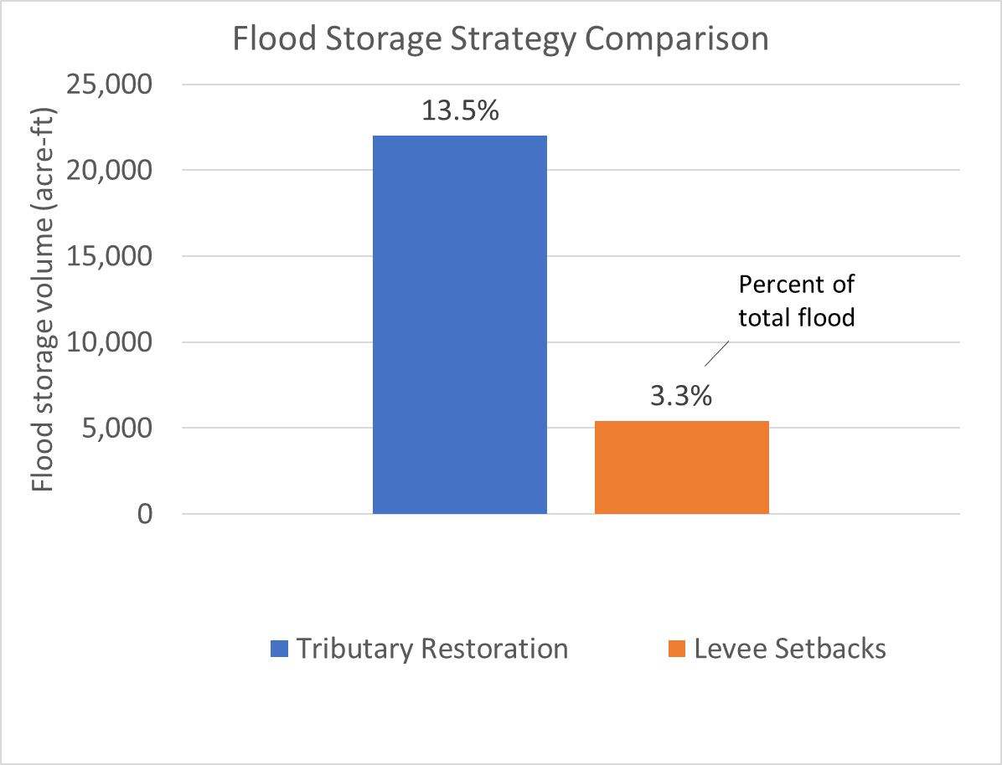
Example: Effectiveness studies

Slide 30
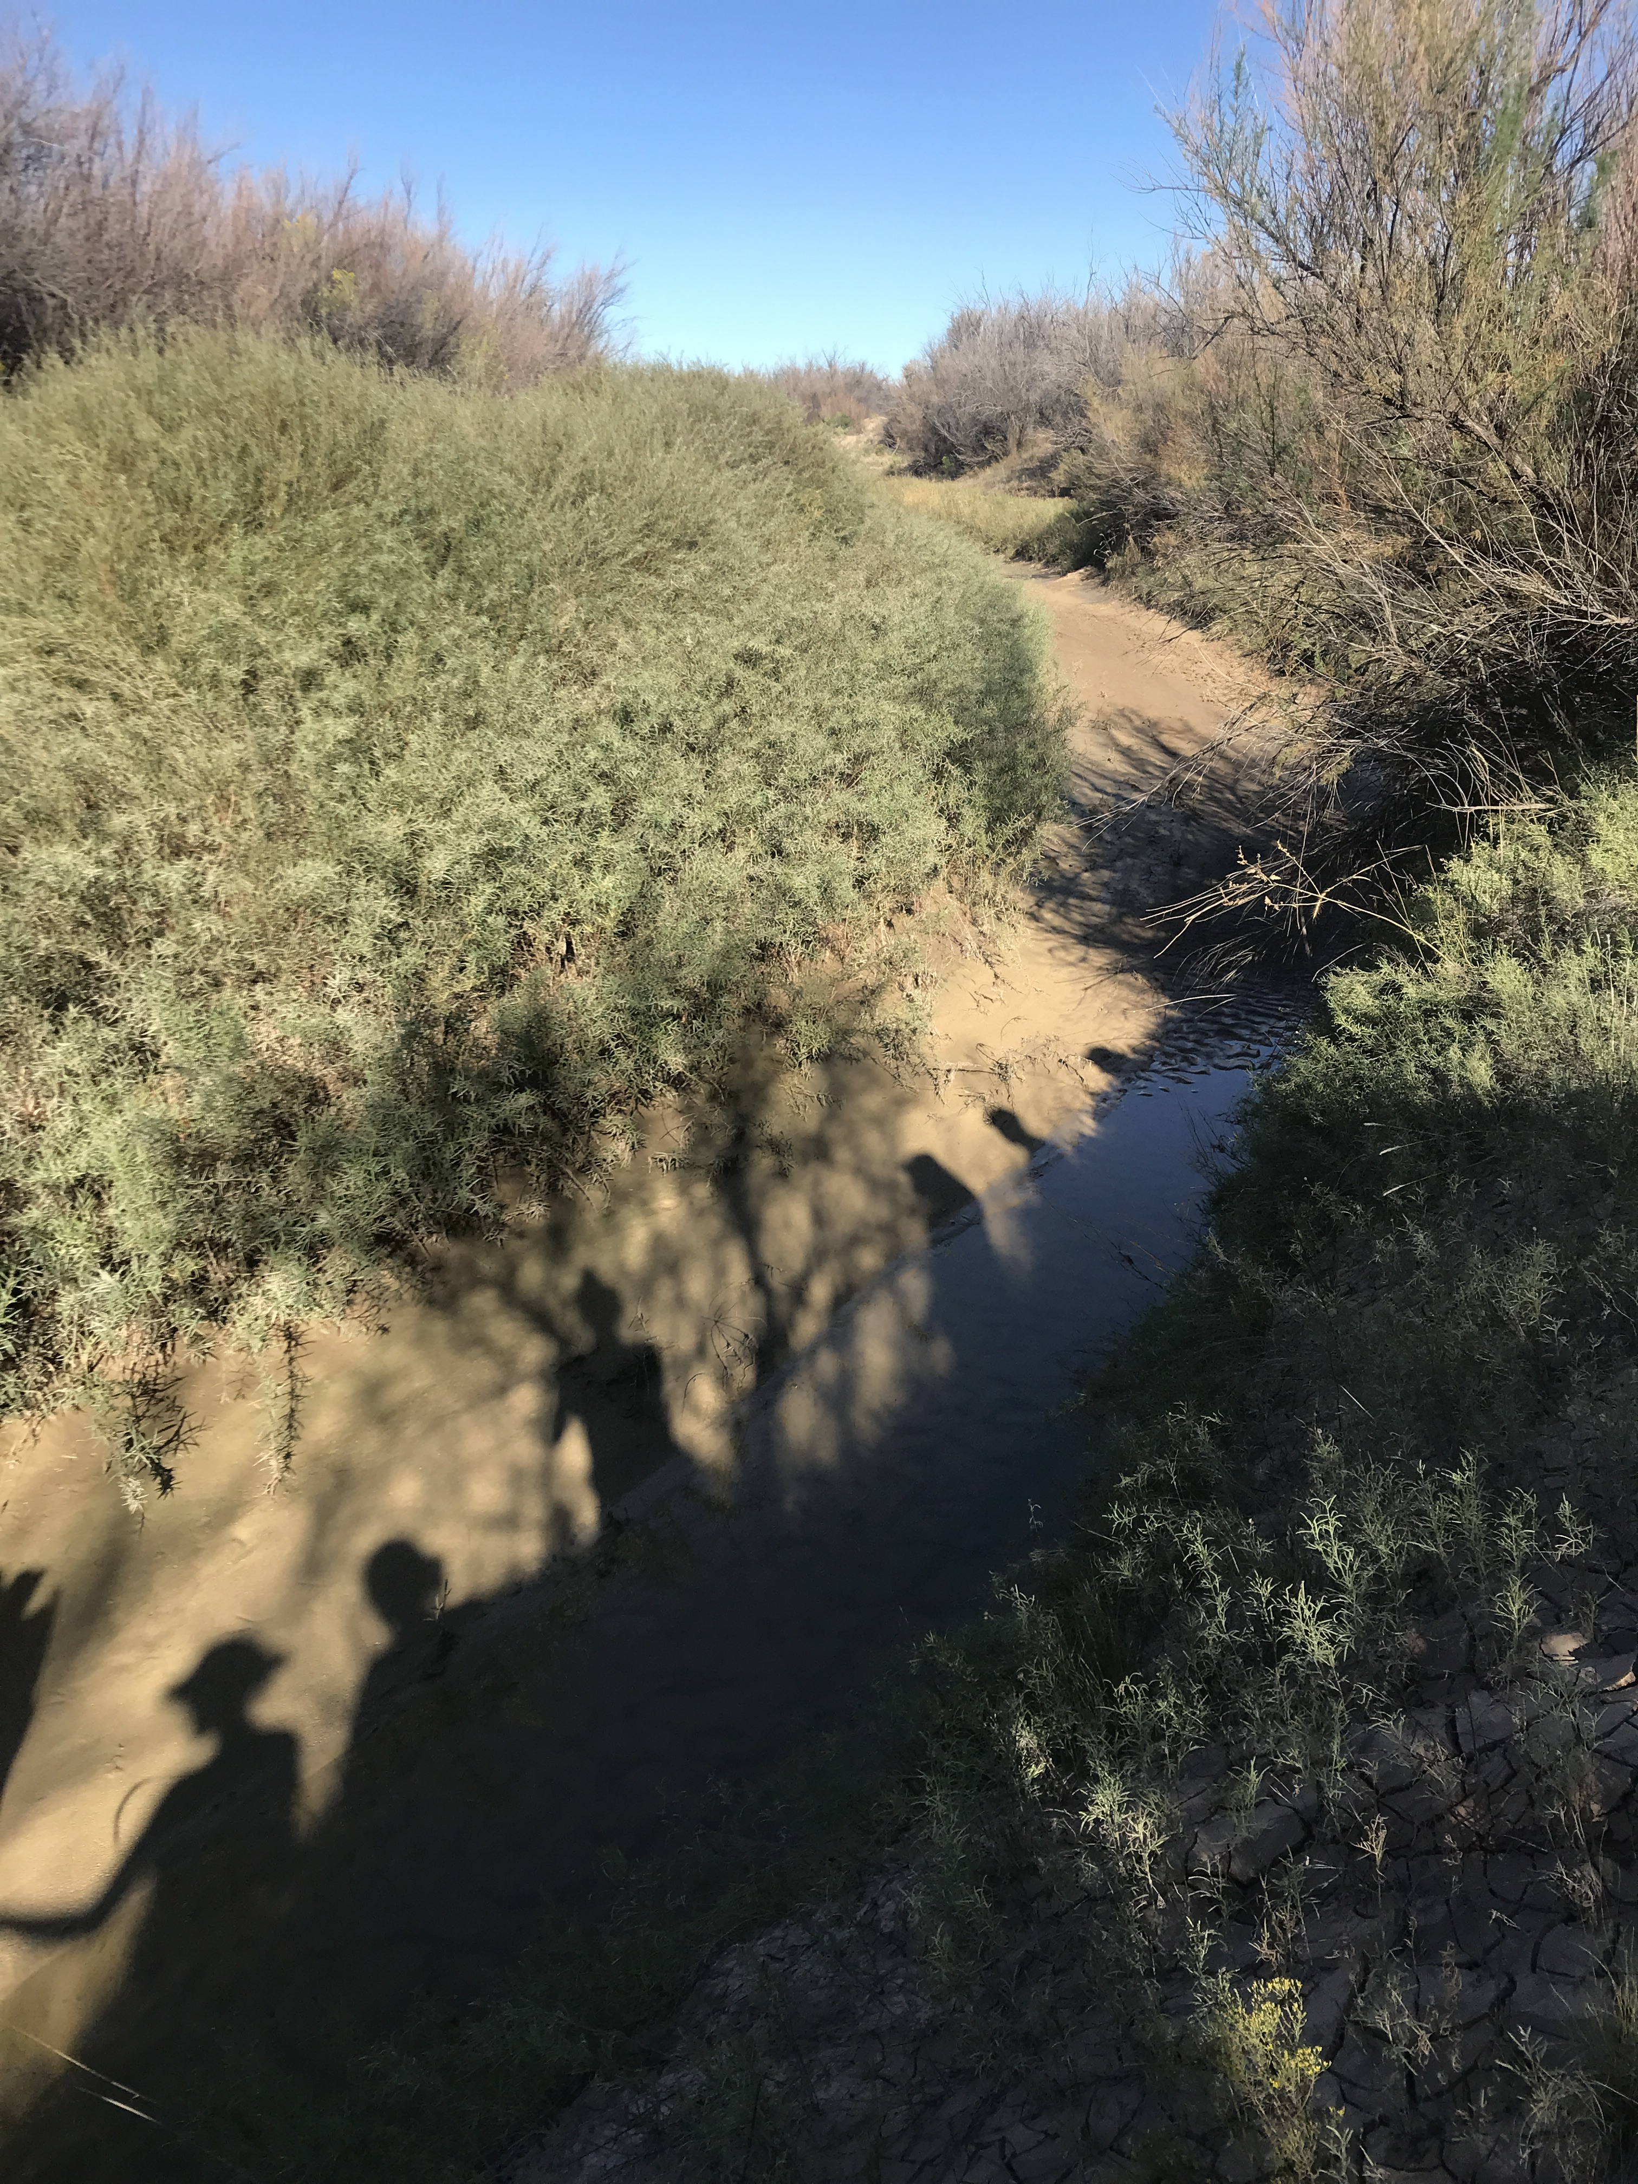
https://cig.uw.edu
gmauger@uw.edu
206.685.0317
Image Credit: Kendra Kaiser

Slide 31
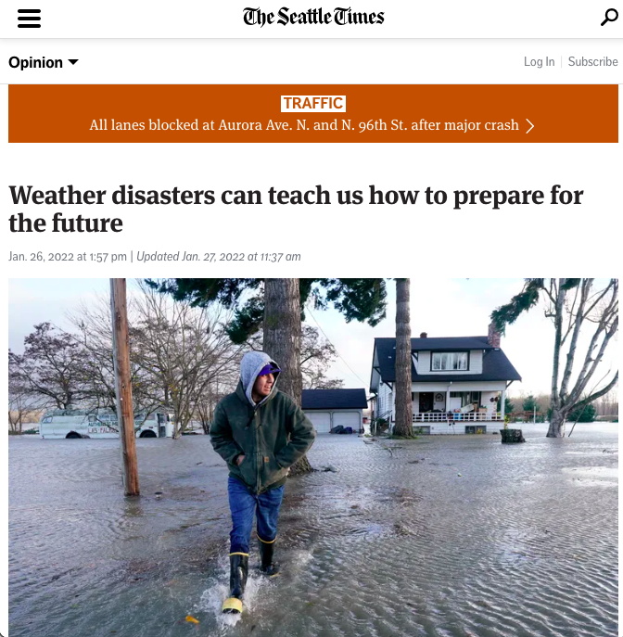
https://www.seattletimes.com/opinion/weather-disasters-can-teach-us-how-to-prepare-for-the-future/

